Slide 1
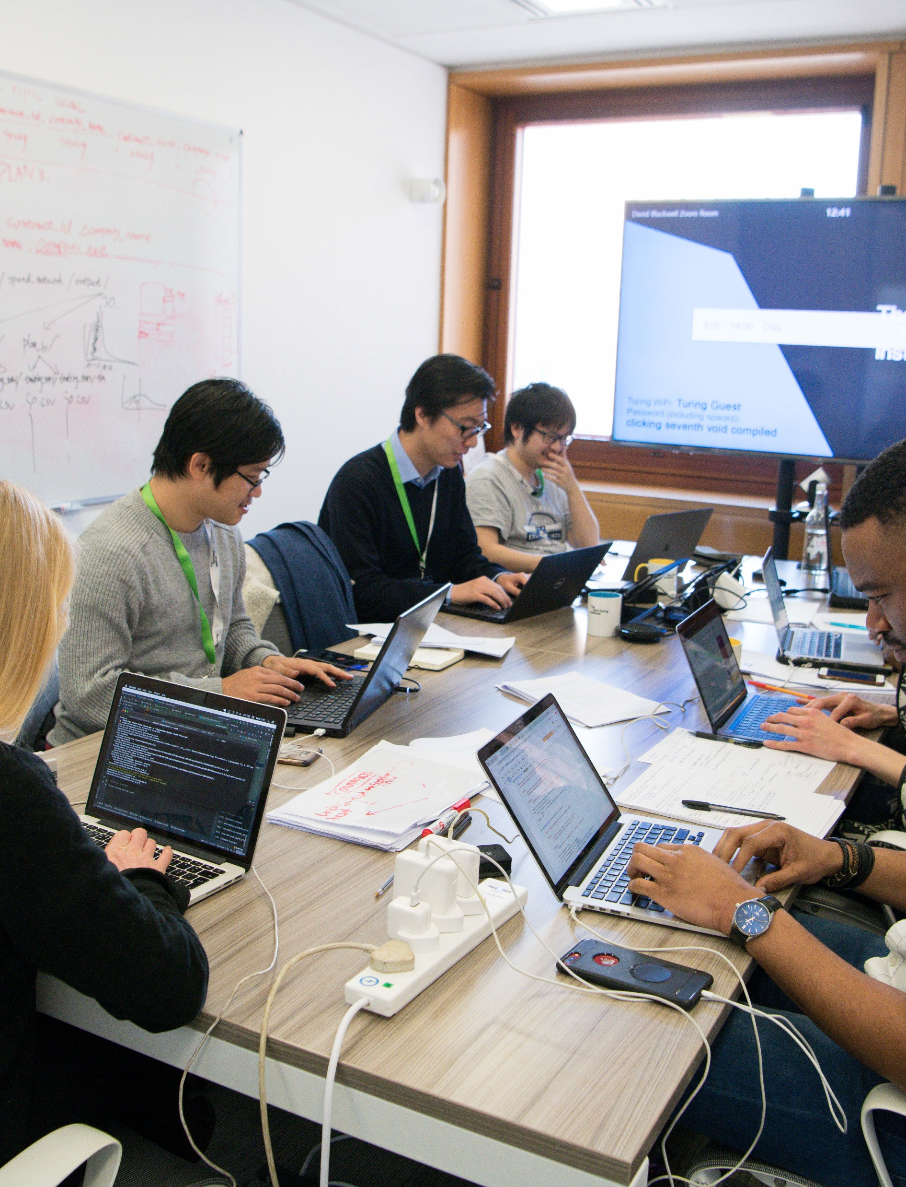
Introduction to the Data Study Group Principle Investigator

Slide 2
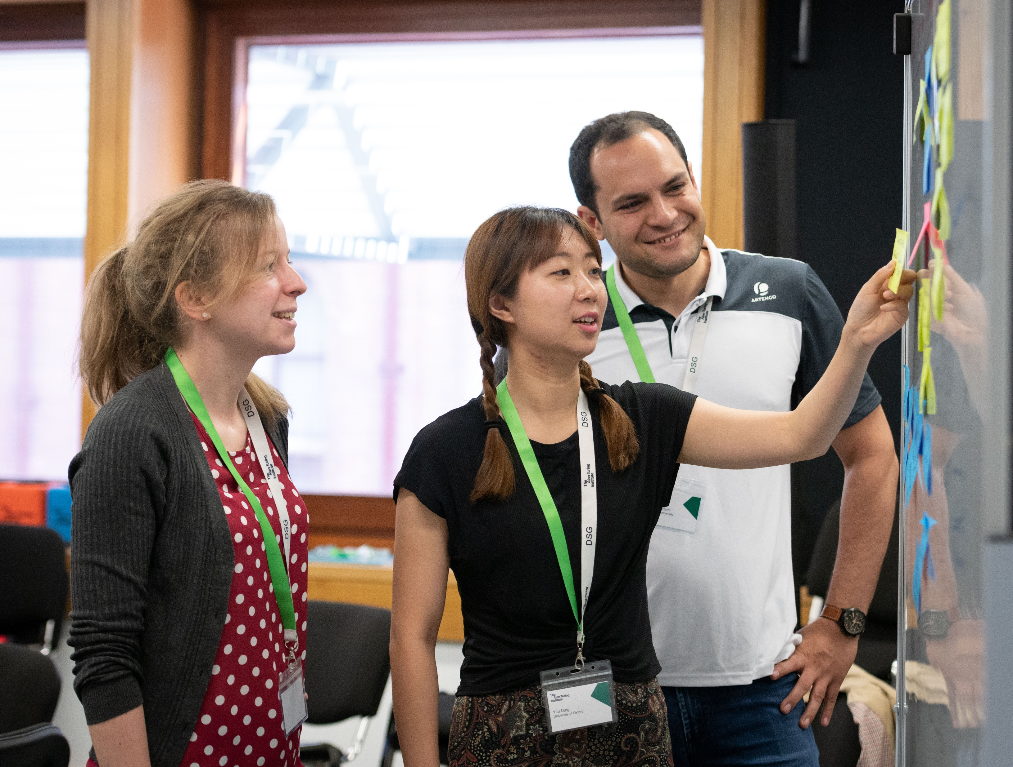
The Data Study Groups
Week long collaborative ‘hackathons’
Organisations act as ‘Challenge Owners’ (COs) who put forth real-world problems to be tackled by small groups of talented and carefully selected researchers.
Researchers brainstorm and engineer data science solutions

Slide 3
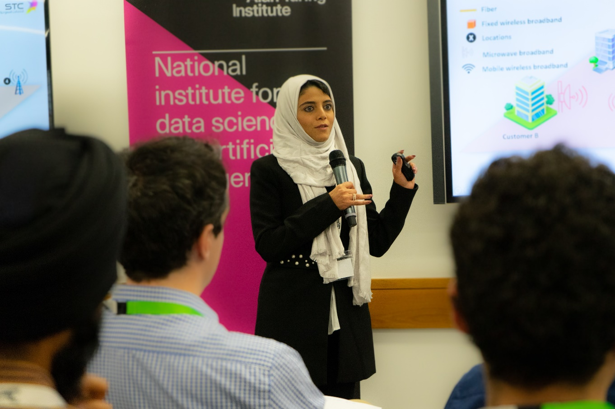
The week
Day 1: Challenges are presented by the organisation
Day 2-4: Brainstorming, modelling and problem solving
Day 5: Progress and recommended routes forward are presented.
Afterwards: The report written during the week is tidied and possible extension of collaboration

Slide 4
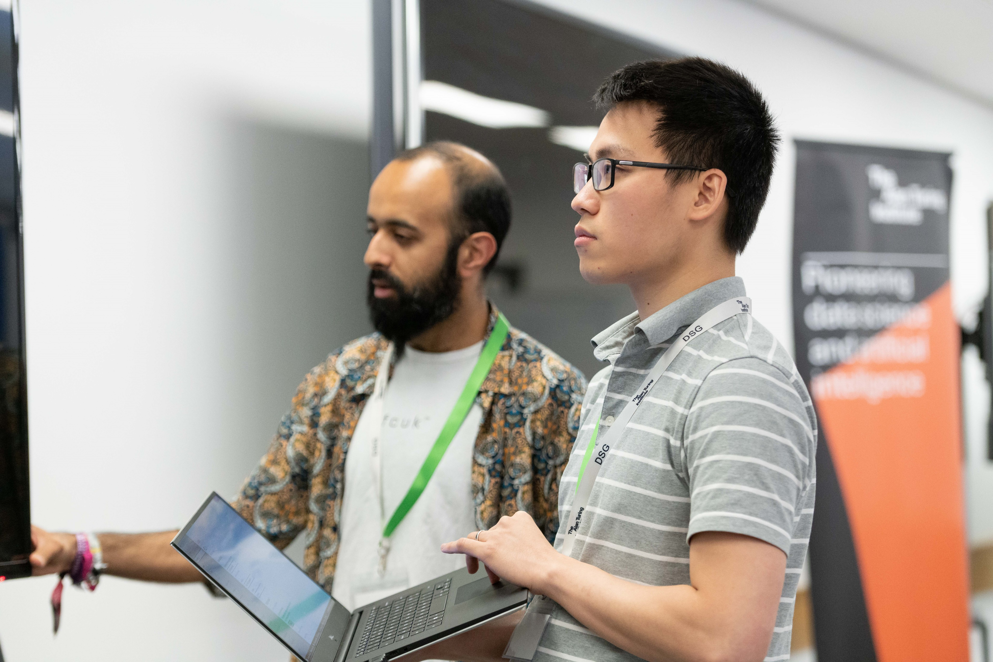
The DSG PI role
PIs liaise with the CO on matters that relate to the research questions that will be investigated during the DSG.
The role of the PI will last on average 6 months per DSG challenge.
This is a voluntary role.

Slide 5
Responsibilities

Slide 6

Defining the challenge
Together the PI and CO write the following documents, helping to define the challenge:
A challenge title, with a 2-sentence description and a short list of relevant participant skill sets
A detailed 2-page challenge description (including data at hand, question(s) to be tackled, approaches suggested, output expectations)

Slide 7

Data considerations
The PI helps evaluate the appropriateness of the data being provided and assess whether the data is challenge-ready
PIs advise the CO on what needs to be done in order to achieve data readiness in time for the DSG
The sensitivity of the data must be assessed

Slide 8

Ethics
The PI will need to submit an Ethics Advisory assessment
Key questions to be answered regarding the ethical
implications of this research:
Consent
Privacy and Security
Other harms

Slide 9
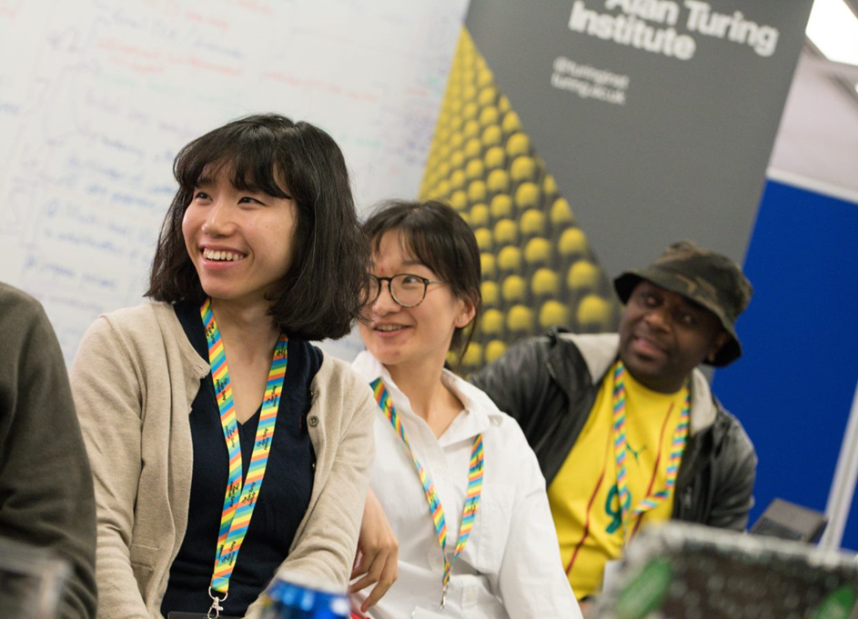
The Report
During the DSG week, participants produce reports explaining their work and findings.
The PI should review the in-progress report and provide feedback during the week.
After the event, PIs finalise the document ready to be published on the Turing website (without conducting any further analysis)

Slide 10
What’s in it for you?
If a follow up project comes out of the DSG, the PI is given the option of first refusal to continue to be involved with the challenge!
The opportunity to work with industry, government or third sector on real data science problems
Lead on a scientific project from start to finish
Grow your scientific and industrial network
Learn to identify and shape collaborative opportunities
We want to encourage publishable papers on the DSG research & where possible, continue the work after the event (£££)

Slide 11
Next steps?
Check the Turing bulletin for new calls for challenge PIs!
More details on the opportunity at: Turing.ac.uk/DSGPI

